Slide 2
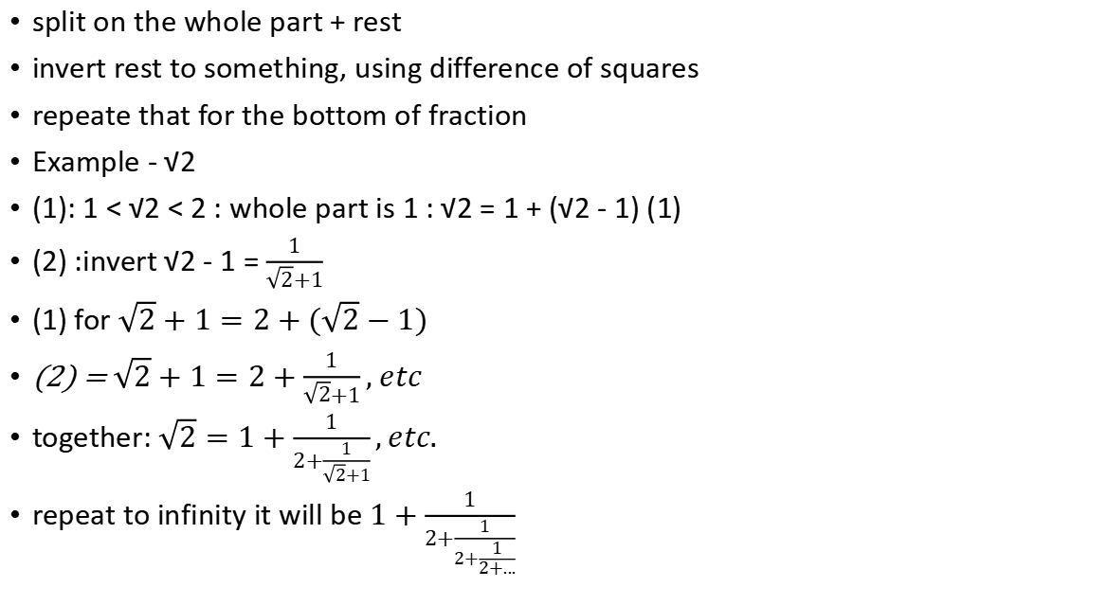
How to turn irrational digit to infinite fraction
split on the whole part + rest
invert rest to something, using difference of squares
repeate that for the bottom of fraction
Example - √2
(1): 1 < √2 < 2 : whole part is 1 : √2 = 1 + (√2 - 1) (1)
(2) :invert √2 - 1 = $\frac{1}{\sqrt{2}+1}$
(1) for $\sqrt{2}+1=2+(\sqrt{2}−1)$
(2) = $\sqrt{2}+1=2+\frac{1}{\sqrt{2}+1}, etc$
together: $\sqrt{2}=1+\frac{1}{2+\frac{1}{\sqrt{2}+1}},etc.$
repeat to infinity it will be $1+\frac{1}{2+\frac{1}{2+\frac{1}{2+...}}}$

